Slide 1
Data Analysis
The Online Shoppers Intention Dataset

Slide 2
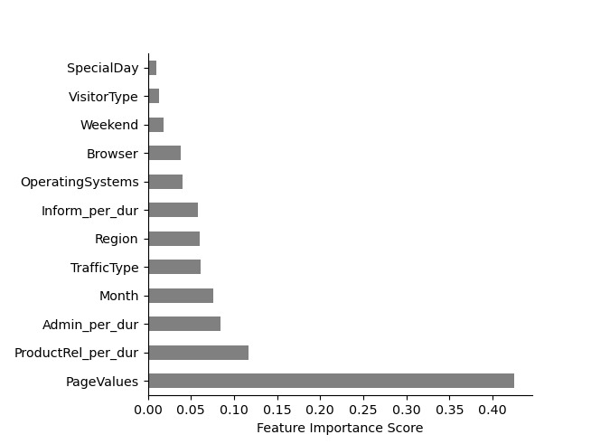
Feature Importance

Slide 3
Counts Of Revenue Generated

Slide 4
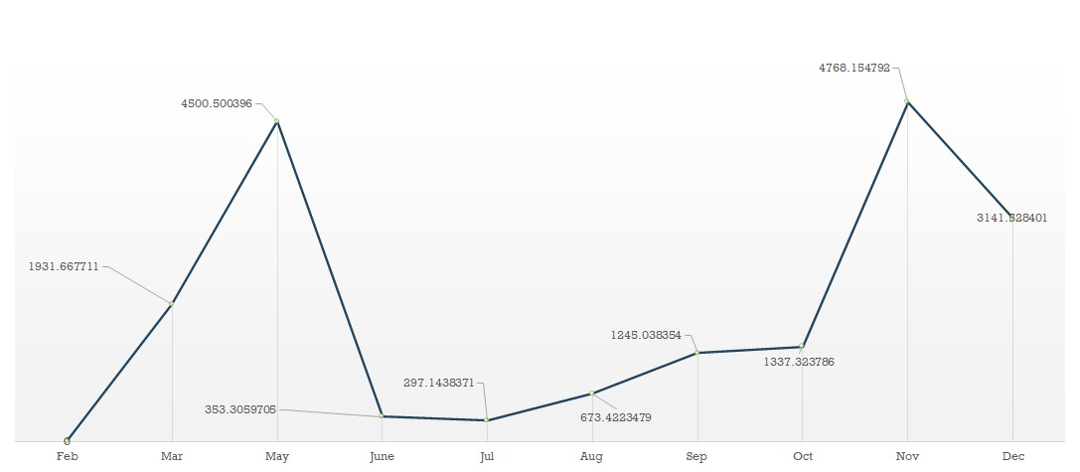
Page Values Over the Year

Slide 5
Shoppers Over the Year

Slide 6
Percentage Of Visitors
Notes:
<number>

Slide 7
Key Points
42.74% of the Revenue was generated in Summer Vacation and about 38.32% of the Revenue generated in Winter Vacation
Though Shoppers visited the site more in Winter Vacation, the higher revenue was generated in the summer
Over 86% of the Customers visited the site, related to the Products, rest of the percentage was related to the Information and Administrative.
According to the data, 85% of the Customers are loyal to the service we are providing, And we need to improve more on increasing the total number of loyal Customers.

Slide 8
Revenue Generated

Slide 9
Shoppers Spread Over the Regions

Slide 10
Browsers Vs OS

Slide 11
Thank you

